Slide 1
Chapter 1: Describing Data with Graphs
By
Ahmad Farooqi, PhD

Slide 2
Outlines of Chapter 1
What is Statistics?
The two Kinds of Statistics
Variables, Experimental units, Sample, and Population Data
Types of Variable-Qualitative and Quantitative variables-Discreate & Continuous
Graphical Representation of Categorical Data-Pie Chats, Bar charts
Graphical Representation of Numerical Data- Bar charts and Line Charts
Steam and Leaf Plots
Interpretation of graphs
Relative Frequency Histograms
Take Home Chapter Review

Slide 3
Learning Outcomes of Chapter 1
On completion of this lesson, with the aid of your course materials, you should be able to:
1. Know and difference between a population data and a sample data
2. Identify and distinguish between quantitative and qualitative variables
3. Construct and interpret Bar and Pie charts for qualitative data
4. Construct and interpret frequency tables for quantitative and use them to build histograms
5. Construct and interpret stem-and-leafs plots and contrast them with histograms

Slide 4
What is Statistics?
Statistics
Formation of Statistical Questions
Data Collection
Organization/Presentation of Data
Test of Significance & Interpretation
Drawing Conclusion & Write up
Descriptive Analysis of Data
Determination of rejection & nonrejection regions, p values, and confidence intervals, along with write up for the statistical analysis.
Is there any association b/w social distancing and COVID?- Should we use 20 seconds to wash our hands during the pandemic?
Data are collected from a sample of subjects with COVID/no COVID, subjects doing social dist./no social dist.-Sample time duration in second are recoded from selected subjects.
Collected data are then presented in the form of tables, graphs, charts, and diagrams
Frequencies are calculated from COVID/no COVID, social dist./no social dist.- Min, Max, mean, median, SD, IQR of time in sec for washing hands.
After checking assumptions, we will apply a statistical test, such as $χ^{2}$test for association and t-test (Wilcoxon test) for hand washing data & provide some explanation and interpretation.
After checking assumptions, we will apply a statistical test, such as χ^2test for association and t-test (Wilcoxon test) for hand washing data & provide some explanation and interpretation.

Slide 5
Kinds of Statistics
Kinds of
Statistics
Descriptive Statistics
(Only for summarization & presentation)
Inferential Statistics
(Only for interpretation, conclusion & reporting)
In Descriptive Statistics, we summarize the given set of data, numerically or graphically
In Inferential Statistics, we use information from sample data to draw an inference about population data

Slide 6
Data, Data Types, and Sources
Data
(Sequence of observations)
Types and Sources
Primary Data
(First time, firsthand & original in nature)
Survey
(Tool to collection info., about service, product, or process from a sample of subjects)
Secondary Data
(Already collected & passes through some statistical/mathematical treatment)
Population cense data, hospital records, thesis/project, questionnaire, registration, personal observation, internet, social media, libraries etc.
Published reports, news, official data, commercially available data, banks, research literature, NGOs, internet, social media, libraries etc.
Written questionnaire, face to face interview, telephonic interview, focus group, e-mail survey, web-base survey etc.
Statistical Experiment
Tossing a coin, rolling a dice, drawing a card from a deck, drawing a ball from an urn etc.
Big Data
(Large volume of data that is difficult to analyze by traditional tools)
Social media, Machine data, Transactional data, Big business and chains are collecting data on a day-to-day basis.

Slide 7
Variable, Experimental Unit, and Data
Statistics is a method of scientific research. It starts with a question of interest which scientists/investigators would like to investigate. This leads to characteristic of interest, a population (experimental units) of interest, the sample to be selected from that population, the measurements to be made on each of the experimental units in the sample.
Variable: A characteristic that changes or varies from time-to-time, subject to subject, or individuals to individual under consideration.
Examples: Height of an individual, Hair color (varies from person to person), white blood cell count (varies from subject to subject), time to failure of a computer component (varies from computer to computer).
Experimental Unit: The individual or object on which a variable is measured.
Measurement: These are the results when a variable is measured on an experimental unit in other words Measurements are assigning numbers to objects with some rules.
A set of measurements, called data, can be either a sample or a population.

Slide 8
Population and Sample
Population
A population consist of all possible observations, individuals, subjects, or content of interest. The number of subjects in a population called population size and normally denoted by N.
Sample
A sample is a part/subset of population. The number of observations, individuals, or subjects in a sample is called a sample size and usually denoted by n.

Slide 9
How Many Variables Have You Measured?
Univariate Data: One variable is measured on a single experimental unit. For example, if you measure the systolic blood pressure (SBP) of 100 subjects, the resulting data are univariate.
Bivariate Data: Two variables are measured on a single experimental unit. For example, if you measure the systolic blood pressure (SBP) and Diastolic blood pressure (DBP) of 100 subjects, the resulting data are Bivariate.
Multivariate Data: More than two variables are measured on a single experimental unit. For example, if you measure the systolic blood pressure (SBP), Diastolic blood pressure (DBP), Age, and Weight of 100 subjects, the resulting data are multivariate.

Slide 10
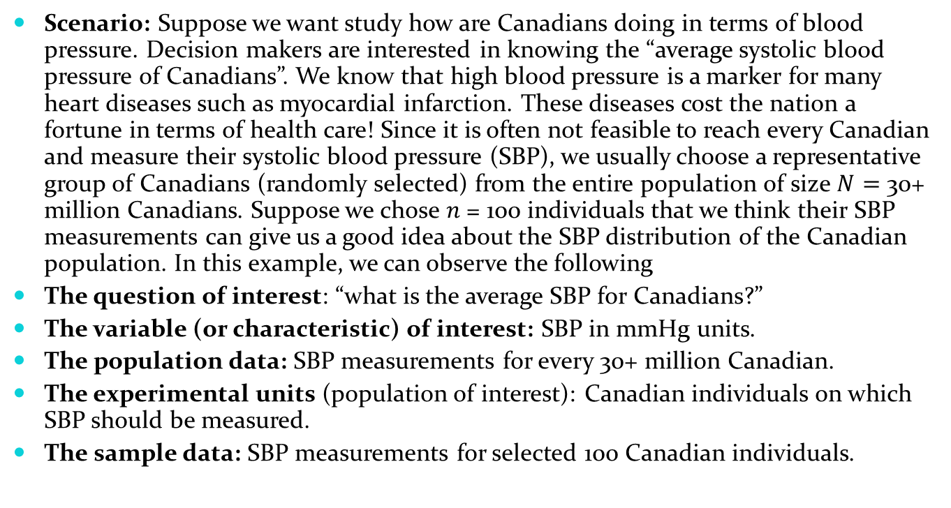
Variables and Data – A Blood Pressure Example
Scenario: Suppose we want study how are Canadians doing in terms of blood pressure. Decision makers are interested in knowing the “average systolic blood pressure of Canadians”. We know that high blood pressure is a marker for many heart diseases such as myocardial infarction. These diseases cost the nation a fortune in terms of health care! Since it is often not feasible to reach every Canadian and measure their systolic blood pressure (SBP), we usually choose a representative group of Canadians (randomly selected) from the entire population of size $N=$ 30+ million Canadians. Suppose we chose 𝑛 = 100 individuals that we think their SBP measurements can give us a good idea about the SBP distribution of the Canadian population. In this example, we can observe the following
The question of interest: “what is the average SBP for Canadians?”
The variable (or characteristic) of interest: SBP in mmHg units.
The population data: SBP measurements for every 30+ million Canadian.
The experimental units (population of interest): Canadian individuals on which SBP should be measured.
The sample data: SBP measurements for selected 100 Canadian individuals.

Slide 11
Your Tern: Variables and Data – A Vehicle Safety Example
Scenario: Suppose we would like to study how Canadian children are doing in terms of safety while they are travelling in vehicles. We know that for children to be as safe as possible during car accidents, they must be correctly fastened in Car safety seats that are appropriate for their age weight and height. For instance, a school aged child (4-8 years old) can be moved from forward facing car seat to booster seat, only if his/her weight is > 40lbs, and height > 40 inches. We are interested in knowing the proportion (percentage) of Canadian children under the age of 14, who are restrained in the correct car seat for their age, weight and height. The sample data collected on 500 children under age 14.
What could be the question of interest?
What is the variable (or characteristic) of interest?
What is the population data?
What is the experimental units?
What is the sample data?

Slide 12
Constant, Variable, and Types of Variable
Variable: Quantity that varies
Quantitative
(Numerical)
Discrete
(Only Whole Numbers)
Continuous
(Decimal Numbers)
Qualitative
(Categorical, Attributes)
Nominal
(Only for Identification)
Ordinal
(Only if Order matters)
Hospital LOS, WBC, number of patients admitted/day, road accident etc.
Temperature, BMI, Income, height, age, reaction time, blood pressure, utility bills etc.
Gender, marital status, race, eye color, area code, blood type, cellphone numbers etc.
Hospital ranking, Likert scale in a survey, pain score, cancer stages, Elevator's Level etc.
Constant: Quantity that remain same
Normal working hr/day, the Canadian minimum wage, number of days in a week etc.

Slide 13
Definitions
Quantitative Variable: A variable that can be measured numerically and can assume whole number or numbers with decimals. There are further two types of quantitative variables.
Quantitative Discrete Variable: A variable that can assume only finite or countable whole numbers. For example, for a particular day the number of road accidents on Highway 401. Number of students admitted at UWindsor on a particular year, white blood cell counts of patients etc.
Quantitative Continuous Variable: A variable that can assume infinitely all possible values of a given interval. For example, time until a light bulb burns out, height of an individual, weight of a cat, blood pressure of a person etc.
Qualitative (Categorical) Variable: A variable that can measure a quality or characteristic (attribute) of an experimental unit. For example, gender, marital status, race, eye color, area code, blood type, cellphone numbers etc.
Note: Note that in statistics, we code the Qualitative (Categorical) Variable, such as (Male=1, Female=2) to do the statistical analysis.

Slide 14
Constant and Types of Variable-Example
Here,
Experimental Unit (subject) is the example of Qualitative (Nominal) variable, Gender is an example of Qualitative (categorical) variable, Fever is an example of constant, Days pressor is an example of Ordinal variable, ICU Length of stay is an example of Quantitative (Discrete) variable, and BMI is an example of Quantitative (Continuous) variable.
Cardiovascular Manifestations at Windsor Regional Hospital
Experimental Unit (Subjects) | Gender | Fever (1=yes, 2= no) | Days pressor | ICU Length of stay in hrs. | BMI
1 | M | 1 | 7 | 19 | 25.10
2 | M | 1 | 3 | 10 | 18.50
3 | F | 1 | 4 | 5 | 17.10
4 | F | 1 | 1 | 7 | 18.40
5 | F | 1 | 5 | 23 | 17.70

Slide 15
Frequency Distribution of Data
Distribution of Data
(Tabular arrangement of data)
Frequency Distribution
Relative Frequency Distribution
Percentage Frequency Distribution
A tabular arrangement of certain variable along with their frequencies
(or numbers)
A relative frequency distribution provides us a list of numbers divided by their total.
RF=Frequency/Total
A percentage frequency just a percentage of the frequencies.
Percentage=100 x RF

Slide 16
Numerical Representation of Qualitative Data-Example
Frequency distribution
Frequency distribution of children with SEPSIS at different age groups in SIRS/SEPSIS (kind of infection) Study at Children’s Hospital Michigan.
Age Group | Frequency (SEPSIS) | Relative Frequency (Frequency/N) | Percentage Frequency (100* RF)
0 day to 1 week 1 week to 1 month 1 month to 1 years 1-5 years 6-12 years | 18 99 1108 2716 1371 | 0.004 (18/5132) 0.020 (99/5132) 0.216 (1108/5132) 0.529 (2716/5132) 0.267 (1371/5132) | 0.40 2.00 21.60 52.90 26.70
Total | N=5132 | 1 | 100

Slide 17
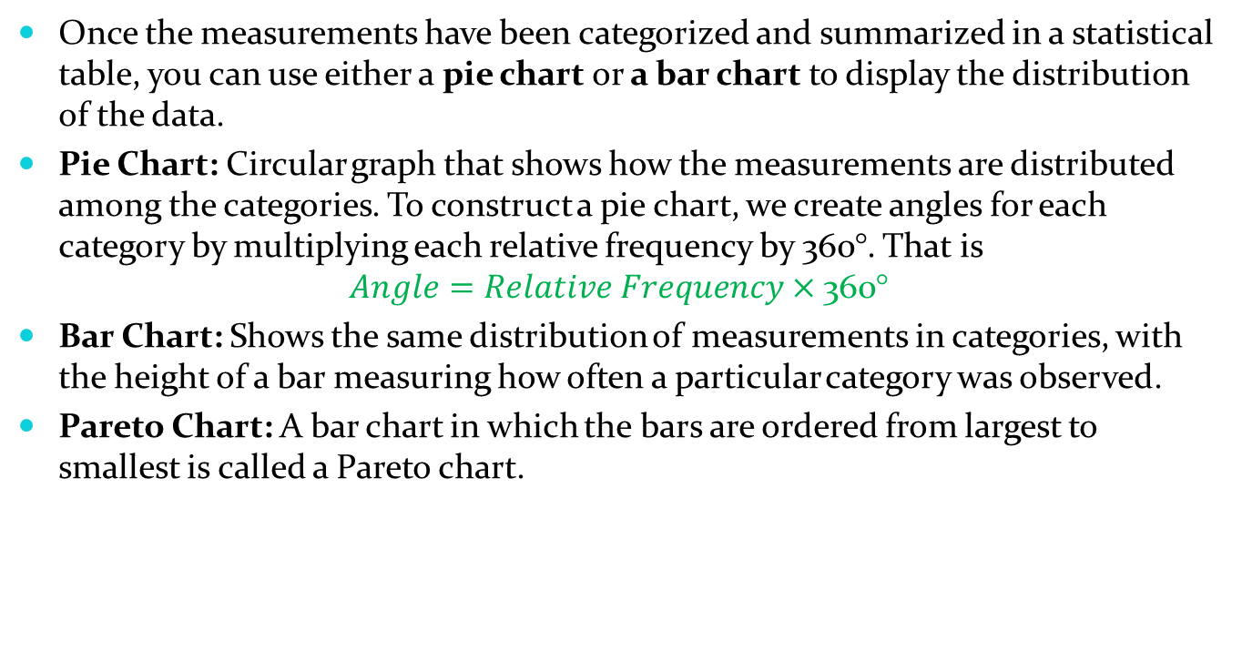
Graphical Representation of Qualitative Data
Once the measurements have been categorized and summarized in a statistical table, you can use either a pie chart or a bar chart to display the distribution of the data.
Pie Chart: Circular graph that shows how the measurements are distributed among the categories. To construct a pie chart, we create angles for each category by multiplying each relative frequency by 360°. That is
$$Angle=Relative Frequency×\text{360°}$$
Bar Chart: Shows the same distribution of measurements in categories, with the height of a bar measuring how often a particular category was observed.
Pareto Chart: A bar chart in which the bars are ordered from largest to smallest is called a Pareto chart.

Slide 18
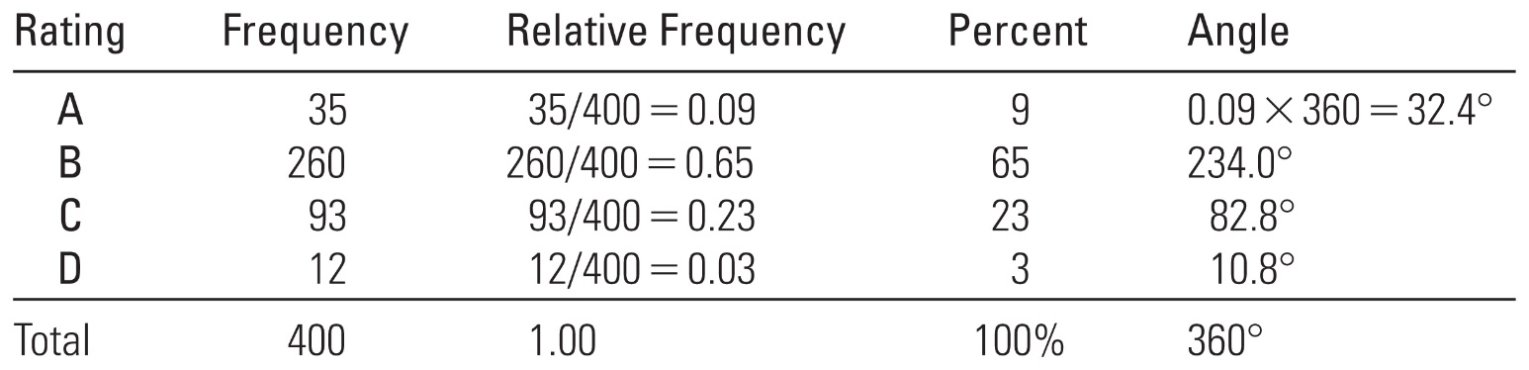

Numerical Representation of Canadian Education Rating by 400 Educators: Construction of Pai Chart-Example
Example: In a survey concerning public education, 400 school administrators were asked to rate the quality of education in Canada.
$$Angle=Relative Frequency×\text{360°}$$

Slide 19
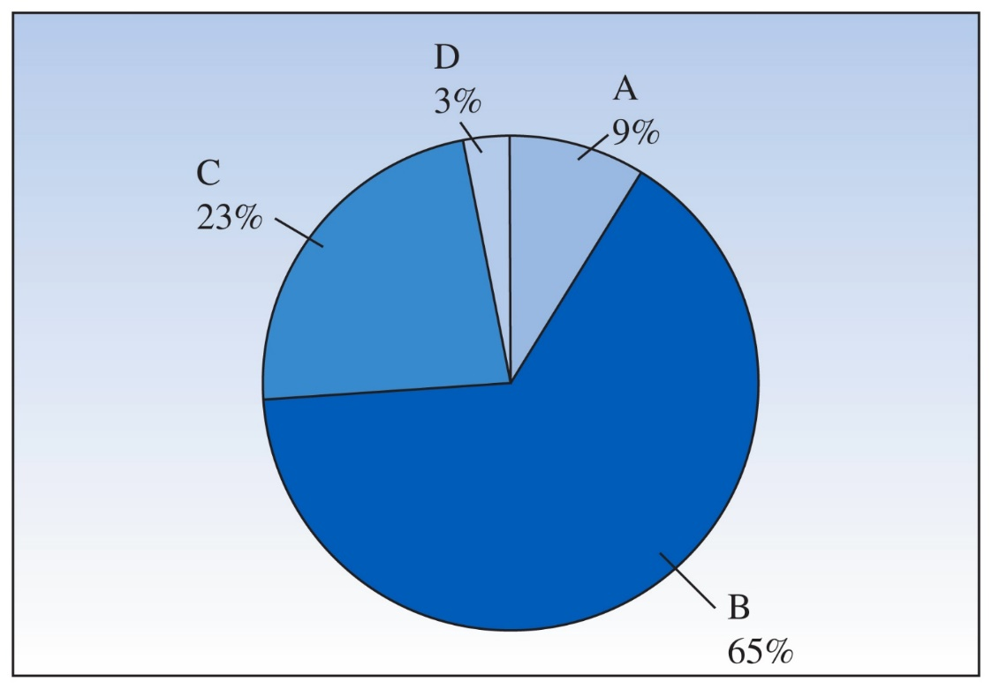

Graphical Representation of Canadian Education Rating by 400 Educators: Pai Chart-Example
Example: In a survey concerning public education, 400 school administrators were asked to rate the quality of education in Canada.
$$Angle=Relative Frequency×\text{360°}$$

Slide 20
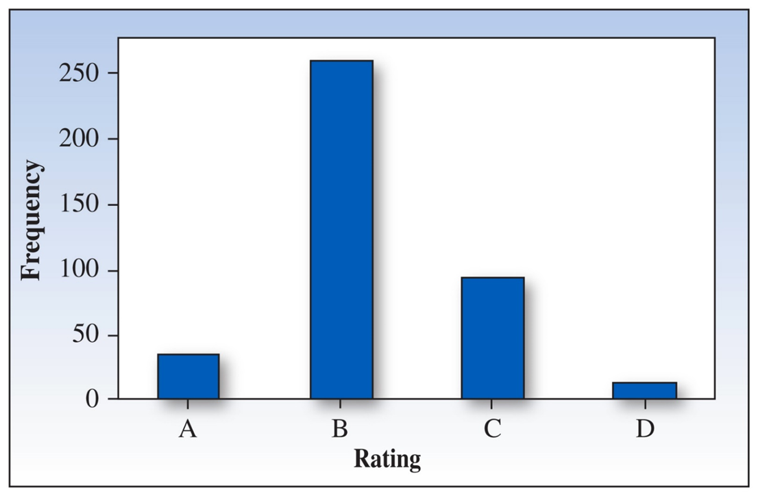
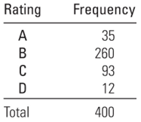
Numerical and Graphical Representation of Canadian Education Rating by 400 Educators: Bar Chart-Example

Slide 21
Graphical Representation of SIRS/SEPSIS (kind of infection) Study: Bar Chart-Example

Slide 22
Numerical Representation of Categorical Data: M&M’s candies-Example
Example 1.7 (Test Book): A snack size bag of peanut M&M’s candies contains 21 candies with the colors shown below with a Raw Data.
m
m
m
m
m
m
m
m
m
m
m
m
m
m
m
m
m
m
m
m
m

Slide 23
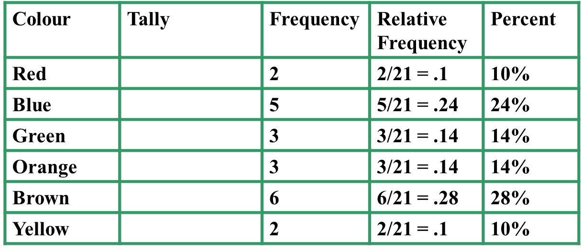
Numerical Representation of Categorical Data: M&M’s candies-Example
Since the variable “color” is qualitative, so our table lists the six categories along with a tally of the number of candies of each color. The last three columns give the three different measures of how often each category occurred.
Statistical Table:
m
m
m
m
m
m
m
m
m
m
m
m
m
m
m
m
m
m
m
m
m
m
m

Slide 24
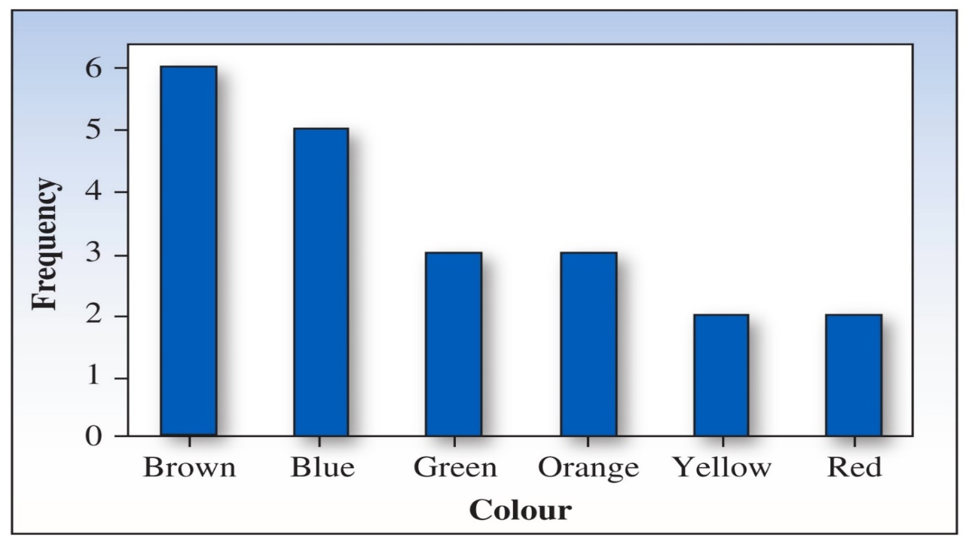
Graphical Representation of Categorical Data: M&M’s candies: Pareto Chart-Example
Since the categories are colors and have no order, you could construct bar charts with many different shapes just by reordering the bars.
To emphasize that brown is the most frequent color, followed by blue, green, and orange, we order the bars from largest to smallest.

Slide 25
Graphical Representation of Quantitative Data
It is to be noted that, a single quantitative variable measured for different population segments or for different categories of classification can be graphed using a pie or bar chart.
The pie chart displays how the total quantity is distributed among the categories.
The bar chart uses the height of the bar to display the amount in a particular category.

Slide 26
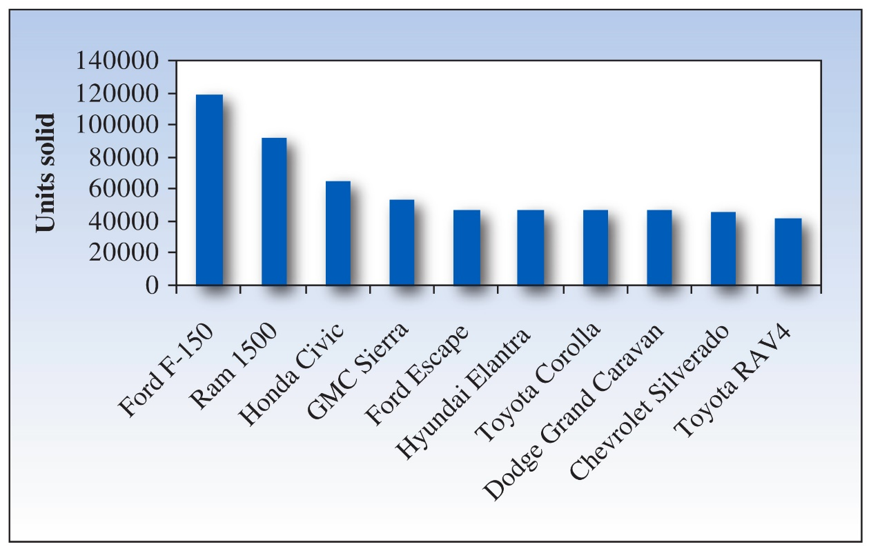
Graphical Representation of Quantitative Data-Example
Example 1.8 (Test Book): The top 10 vehicles sold in Canada for 2015.

Slide 27
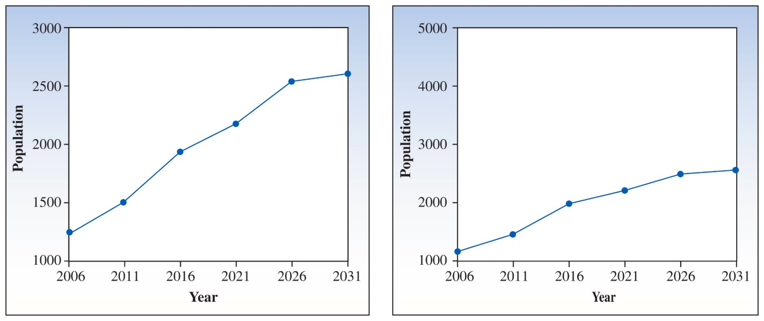
Graphical Representation of Quantitative Data: Time Series
Time Series Graph: A single quantitative variable measured over time; can be graphed using a line chart.
Canadian population growth projections for age group 65–69
Notes:
Figure 1.8, p. 22
Notice the marked difference in the vertical scales of the two graphs. Shrinking the scale on the vertical axis causes large changes to appear small, and vice versa.

Slide 28
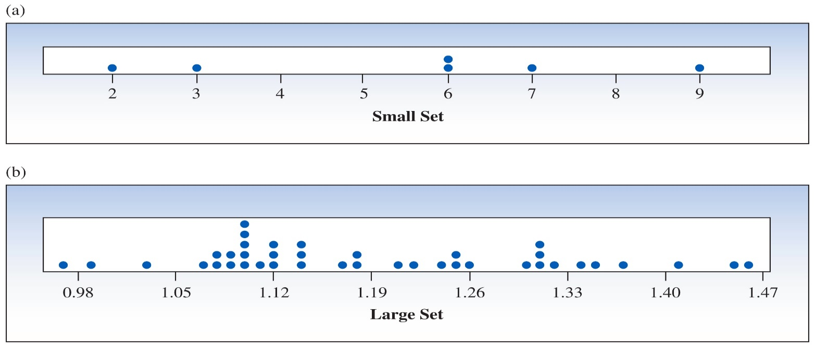
Graphical Representation of Quantitative Data: Dot Plots
Dot plots: The simplest graph for quantitative data, dot plots which plot the measurements as points on a horizontal axis, stacking the points that duplicate existing points.
Note: Note that, For a large data set, the dotplot can be uninformative and tedious to interpret

Slide 29
Graphical Representation of Quantitative Data: Steam and Leaf Plots
Stem and Leaf Plots: It is a simple graph to arrange the quantitative data that uses the actual numerical values of each data point developed by Jhon Tukey (1977).
Divide each measurement into two parts: the stem (leading digit) and the leaf (trailing digit).
List the stems in a column, with a vertical line to their right.
For each measurement, record the leaf portion in the same row as its matching stem.
Arrange the leaves from lowest to highest in each stem.
Provide a key to your coding so the reader can re-create the actual measurements if necessary.
Note: Note that, a stem is the leading digit(s) and leaf is the rest of the measurement. For example, the measurement 243 could be split in two ways
Steam | Leaf
2 | 43
Steam | Leaf
24 | 3

Slide 30
Graphical Representation of Quantitative Data: Steam and Leaf Plots-Example
Example 1.10 (Textbook): The prices ($) of 19 brands of walking shoes:
90 70 70 70 75 70 65 68 60
74 70 95 75 70 68 65 40 65 70
Steam Leaf’s
9 0 5
7 0 0 0 5 0 4 0 5 0 0
6 5 8 0 8 5 5
4 0
Steam Leaf’s
4 0
6 0 5 5 5 8 8
7 0 0 0 0 0 0 0 4 5 5
9 0 5
Reorder

Slide 31
Graphical Representation of Quantitative Data: Steam and Leaf Plots-Example
Note that, sometimes the available stem choices result in a plot that contains too few stems and many leaves within each stem.
In this situation, you can stretch the stems by dividing each one into several lines, depending on the leaf values assigned to them.
Stems are usually divided in one of two ways:
Into two lines, with leaves 0-4 in the first line and leaves 5-9 in the second line.
Into five lines, with leaves 0-1, 2-3, 4-5, 6-7, and 8-9 in the five lines.

Slide 32
Graphical Representation of Quantitative Data: Steam and Leaf Plots-Exercise
Exercise: Suppose we have the data : 0.0076, 0.0100, 0.0400, 0.1266, 0.1917, 0.2598, 0.3000, 0.3752, 0.6244, 1.0200
How would you build a stem and leaf’s plot?
Solution: Looking at these numbers we notice that: the largest number is 1.02 and the smallest number is 0.0076. Now, since most of them are less than one, but are in the order of one decimal digit, we prefer to take the leaf unit 0.1 and we spread out some of the tallest stacks to make the plot more readable.
Here is the stem and leaf’s plot
Stem Leaf
0 0 0 0 1 1
0 2 3 3
0 6
1 0

Slide 33
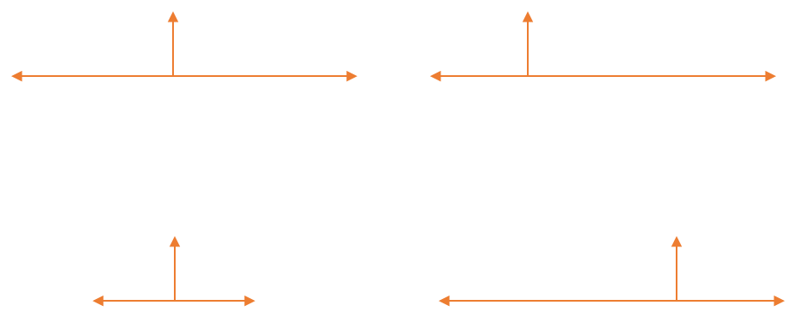
Interpretation of Graphs with Location and Spread
Where is the data located (centred) on the horizontal axis, and how does it spread (variability) out from the centre? Following figures can help to understand this.

Slide 34
Interpretation of Graphs by Shapes
Mound Shaped and Symmetric: Mirror images to the left and right from the Centre.
Skewed Right: Tail on the right side: A few unusually large measurements.
Skewed Left: Tail on the left side: A few unusually small measurements.
Bimodal: Two local peaks.

Slide 35
Interpretation of Graphs with Outliers
Are there any strange or unusual measurements that stand out in the data set? if yes this called outlier in statistics. In simple words, outliers are the data points that do not fit well with the pattern of the rest of the data.
No Outliers
Outlier

Slide 36
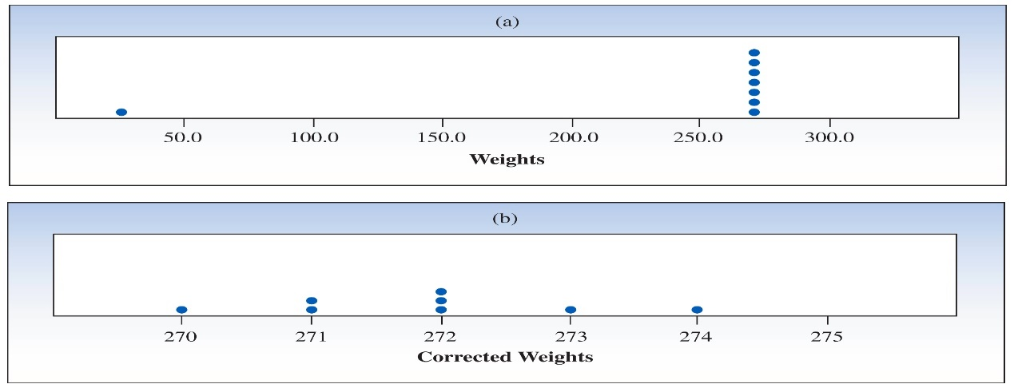
Interpretation of Graphs with Outliers-Example
Example 1.13 (Textbook): A quality control analyst records the weights (in grams) of 8 randomly selected walking shoes but accidentally misplaces the decimal point in the last entry: 272, 274, 270, 271, 271, 273, 272, 27.2.
How does dot plot (a) help us identify this outlier?
After correcting the error in data entry, we make dot plot (b). How would we describe this distribution?

Slide 37
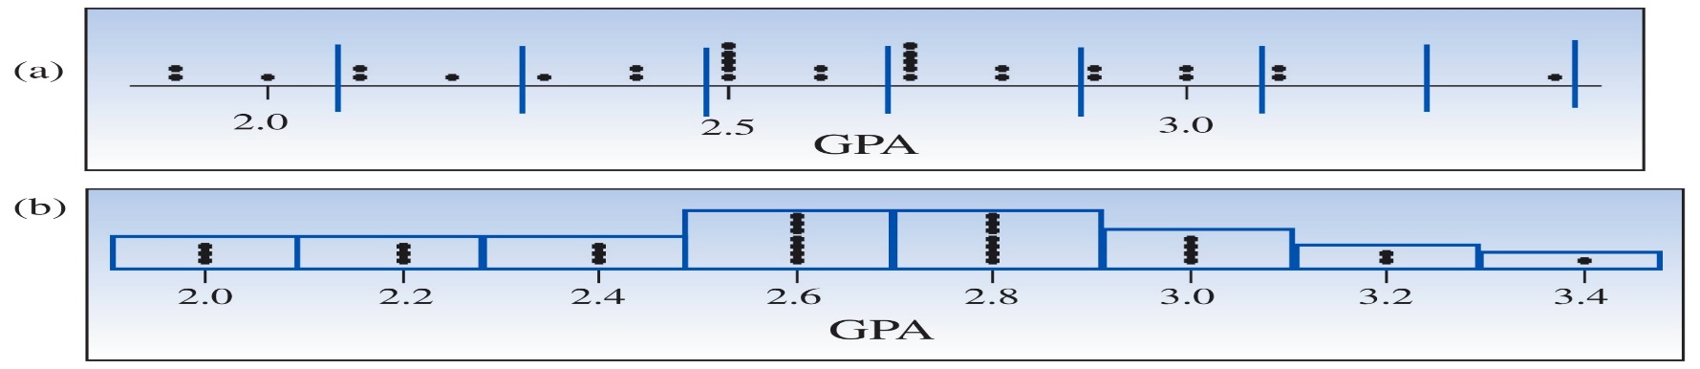
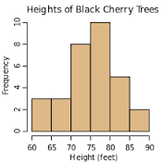
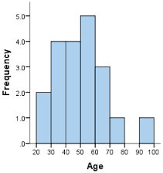
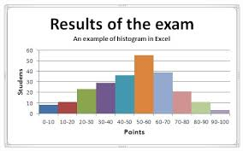
Relative Frequency Histograms
Histograms or Relative Frequency Histograms, breaks the range of data into a smaller number of equal-width intervals. This produces graphical information about the observed distribution by highlighting where data values cluster.

Slide 38
Relative Frequency Histograms – Process
Divide the range of the data into 5–12 subintervals of equal length.
Calculate the approximate width of the subinterval as range/number of subintervals.
Round the approximate width up to a convenient value.
Use the method of left inclusion, including the left endpoint but not the right, in your tally.
Create a statistical table including the subintervals, their frequencies, and relative frequencies.
Draw the relative frequency histogram, plotting the subintervals on the horizontal axis and the relative frequencies on the vertical axis.

Slide 39
Relative Frequency Histograms – Uses
A relative frequency histogram can be used to describe the distribution of a set of data in terms of its location and shape, and to check for outliers.
The height of a bar represents:
The proportion of measurements falling in that class or subinterval.
The probability that a single measurement, drawn at random from the set, will belong to that class or subinterval.
If the data are discrete:
One class might be assigned for each integer value taken on by the data, or
A large number of integer values may need to be grouped into classes.

Slide 40

Relative Frequency Histograms- Example
Grade Point Averages of 30 First-Year University Students are given below
Step 1: We choose to use 8 intervals.
Step 2: Minimum class width $=\frac{(max value–\min{value})}{interval}$
$$=(3.4 – 1.9)/8 = 0.1875≅0.2$$
Step 3: Convenient class width $= 0.2$.
Use 8 classes of length 0.2, starting at 1.9.
Steps 4 and 5: Create our statistical table of tallies:
2.0 3.1 1.9 2.5 1.9 2.3 2.6 3.1 2.5 2.1
2.9 3.0 2.7 2.5 2.4 2.7 2.5 2.4 3.0 3.4
2.6 2.8 2.5 2.7 2.9 2.7 2.8 2.2 2.7 2.1

Slide 41
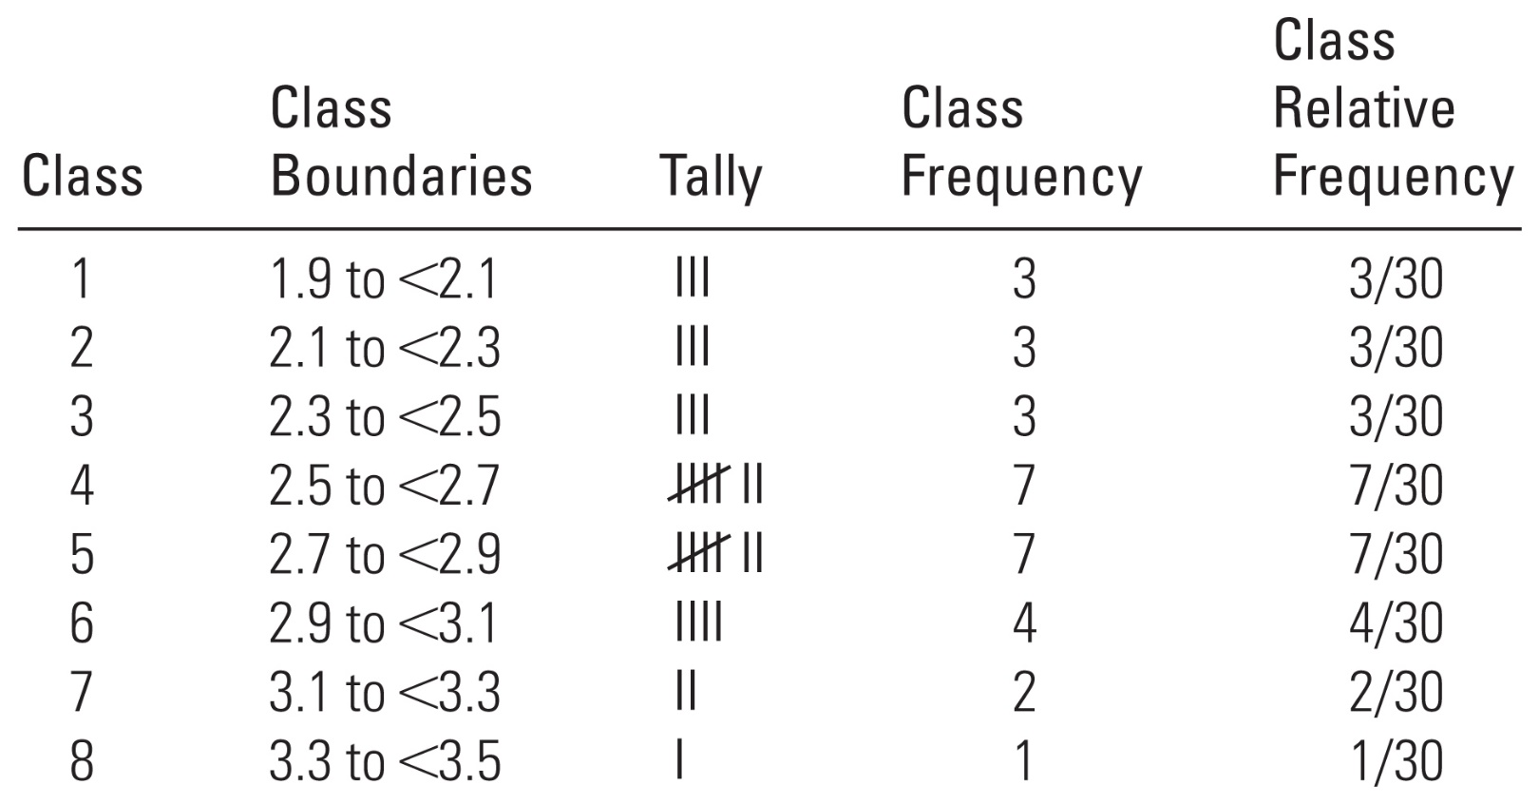
Relative Frequency Histograms- Example (cont’d)
Statistical Table:

Slide 42
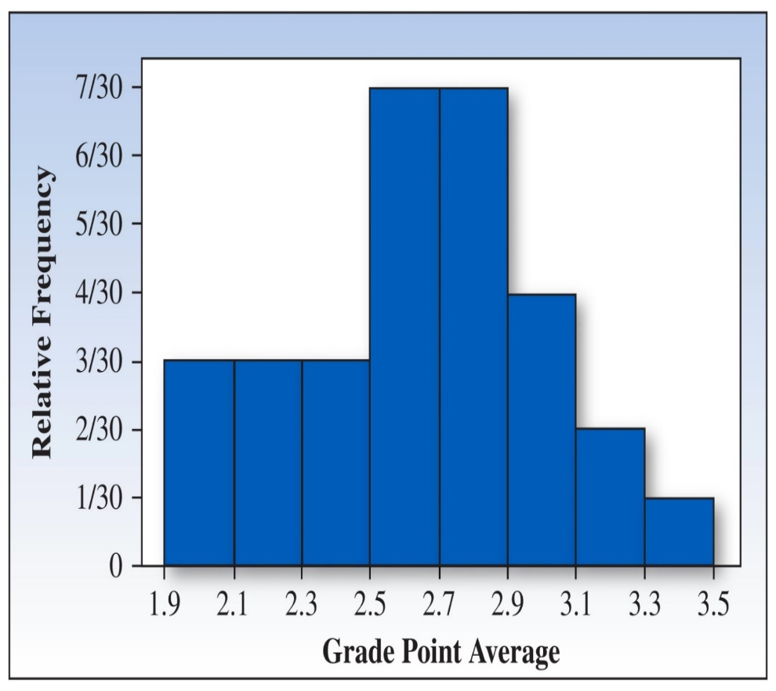
Relative Frequency Histograms- Example (cont’d)
Histogram:
What is the Shape of Dist.? | Relatively Symmetric
Any Outliers? | No
Proportion of the students had GPAs of 2.7 or higher? | (7 + 4 + 2 + 1)/30 = 14/30*100 = 0.47*100 =47%
Probability that a randomly selected student had a GPA of 2.7 or higher? | (7 + 4 + 2 + 1)/30 = 14/30 = 0.47

Slide 43
Histogram – Blood Pressure-Example (cont’d)
Example-Blood Pressure: For the blood pressure data we have constructed the following frequency table:
Observation Number | SBP | Observation Number | SBP
1 | 110 | 21 | 129
2 | 127 | 22 | 150
3 | 135 | 23 | 116
4 | 120 | 24 | 121
5 | 169 | 25 | 127
6 | 104 | 26 | 124
7 | 140 | 27 | 128
8 | 116 | 28 | 131
9 | 137 | 29 | 139
10 | 138 | 30 | 159
11 | 124 | 31 | 126
12 | 153 | 32 | 127
13 | 145 | 33 | 126
14 | 115 | 34 | 139
15 | 122 | 35 | 109
16 | 175 | 36 | 121
17 | 172 | 37 | 92
18 | 111 | 38 | 131
19 | 103 | 39 | 152
20 | 108 | 40 | 142
Class | Class boundaries | Class frequency | Class relative frequency | Percent (%)
1 | 92 to < 104 | 3 | 0.075 | 7.5
2 | 104 to < 116 | 7 | 0.175 | 17.5
3 | 116 to < 128 | 12 | 0.30 | 30.0
4 | 128 to < 140 | 9 | 0.225 | 22.5
5 | 140 to < 152 | 4 | 0.10 | 10.0
6 | 152 to < 164 | 2 | 0.05 | 5.0
7 | 164 to < 176 | 3 | 0.075 | 7.5

Slide 44
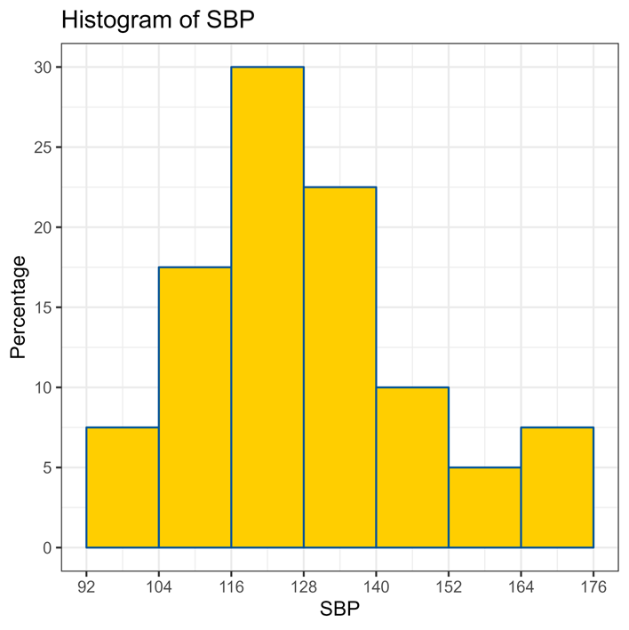
Histogram – Blood Pressure-Example (cont’d)
Example-Blood Pressure (cont’d):
Using 7 classes with a class width of 12, we create the following histogram:
Questions:
What is the percentage of Canadians with SBP lower than 152 mmHg?
Where is (approximately) the center of the SBP distribution?
How does the SBP distribution look like?
Answers:
The percentage is 87.5 % of Canadians with SBP lower than 152 mmHg?
The center of the SBP distribution seems to be around 128 mmHg?
The distribution looks slightly rightly skewed?

Slide 45
Relative Frequency Histograms-Exercise
Exercise: For the blood pressure data, we have constructed the following frequency table and histogram
Frequency table for the blood pressure data
Class Class boundaries frequency relative frequency Percent (%)
1 92.00 to < 103.86 2 0.05 5.0
2 103.86 to < 115.72 6 0.16 16.0
3 115.72 to < 127.58 13 0.325 32.5
4 127.58 to < 139.44 9 0.225 22.5
5 139.44 to < 151.30 4 0.10 10.0
6 151.30 to < 163.16 3 0.075 7.5
7 163.16 to < 175.02 3 0.075 7.5

Slide 46
Relative Frequency Histograms-Exercise (cont’d)
Some important questions to reflect on:
1. What is the percentage of Canadians with SBP lower than 151 mmHg?
2. Where is (approximately) the center of the SBP distribution?
3. How does the SBP distribution look like?
Answer: Do yourself!

Slide 47
Chapter Review – Key Concepts (Part 1 & 2)
How Data Are Generated:
Experimental units, variables, measurements
Samples and populations
Univariate, bivariate, and multivariate data
Types of Variables: Qualitative or Categorical
Quantitative
Discrete
Continuous

Slide 48
Chapter Review – Key Concepts (Part 3)
Graphs for Univariate Data Distributions
Qualitative or Categorical data:
Pie charts
Bar charts
Quantitative Data:
Pie and bar charts
Line charts
Dot plots
Stem and leaf plots
Relative frequency histograms (Histogram)

Slide 49
Chapter Review – Key Concepts (Part 4)
Describing data distributions:
Shapes – symmetric, skewed left, skewed right, unimodal, bimodal
Proportion of measurements in certain intervals
Outliers

Slide 50
References
Textbook: Mendenhall, W., Ahmed, S.E., Beaver, R. and Beaver B.: Introduction to Probability and Statistics, Fourth Canadian Edition, Nelson (2018).
Notes STAT-2910, Dr. Kevin Granville

